Slide 1
IPAC GTA 3M Chapter Achievement Award Submission
YEAR 2021
Prepared by Melisa Avaness - president

Slide 2
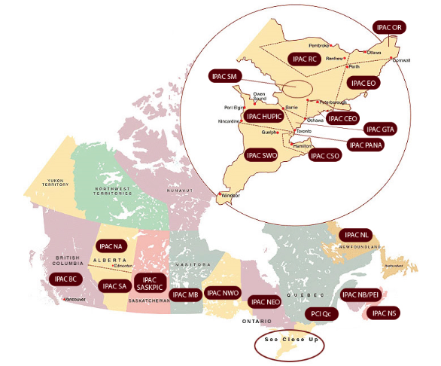
IPAC GTA Region
Established in 1980, IPAC GTA is the first chapter of IPAC Canada (originally named as TPIC). It primarily serves the Greater Toronto Area, including the city of Toronto and surrounding areas bordered by Mississauga, Barrie, Orillia and Oshawa. Some of our membership extends beyond these areas.

Slide 3
Our members
IPAC GTA is the largest chapter in Ontario with an average membership of 300. Our members represent diverse educational backgrounds and workplaces, including:
Acute care
Long Term Care
Complex Continuing/Rehabilitation Care
Mental Health
Provincial Government
Public Health
Correctional Services
Dental health care
Correctional Services
Community Organizations
Private Industry

Slide 4
IPAC GTA Executives 2021
President: Melissa Avaness BSc, BASc, CIC
President-elect: Alice, Simanescu MPH, CIC
Past-president: Kamyab Ghatan, MD, CIC
Secretary: Cameron Thomas BSc, CIC
Treasurer: Sarah Zanchettin MHA, CIC
Marketing Chair: Murtuza Diwan MSc CIC
Networking Co-Chair: Kishori Naik BSc, CIC
Networking Co-Chair: Dechan Dolma BSc, CIC
Webmaster: Murtuza Diwan MSc CIC
Webmaster: Stefanie Siaw BSc, CIC
Education Committee Chair: Alex Kusiewicz MSc, CIC

Slide 5
Purpose, mission and vision
Purpose: To reduce the risk of infection across the care continuum by promoting excellence in the principles and practice of infection prevention and control in health care settings and in the community through education, communication, networking, research and public awareness. As a chapter we endorse the mission, vision and values of IPAC-Canada.
Mission: IPAC-GTA is a regional, multidisciplinary association committed to the wellness and safety of Canadians by promoting best practice in infection prevention and control through education, standards, advocacy and consumer awareness.
Vision: IPAC-GTA will be a regional leader and the recognized resource for the promotion of best practice in infection prevention and control.

Slide 6
IPAC GTA Objectives
Promote and increase membership engagement
Membership engagement
Engage members from broader sectors (e.g. Environmental services partners, dental setting, etc.)
Knowledge transfer: provide educational resource/content through IPAC CHATs, Education day, Journal club, etc.
Increase social media presence
Provide CIC study group for membership and beyond-
Prepare and inspire members for CIC certification/recertification
Organize social events if permitted

Slide 7
IPAC GTA- Membership
Membership over last five years
IPAC GTA membership has increased steadily over the past five years.

Slide 8
Goals/objectives of 2020
Promote and increase membership
Membership engagement
Engage members from broader sectors (e.g. Environmental services partners, dental setting, etc.)
Provide educational resource/content through IPAC CHATs, Education day, Journal club, etc.
Increase social media presence
Continue CIC study group
Social events
Review policies

Slide 9
IPAC GTA- Membership
Membership over last five years

Slide 10
IPAC GTA Meetings
IPAC GTA maintained engagement, provided educationally content and facilitated knowledge sharing Virtually by IPAC CHATs via ZOOM platform
Hosted 7 CHATs
Over 350 participant
Jul 7, 2021. “A walk through my notes from 2021 IPAC conferences. "Speaker: Barley Chironda (Clorox Company)
July 22, 2021. “Mobile Health Unit at Sunnybrook- IP&C role in implementation and outcome”. Speaker: Paige Reason (Sunnybrook Health Sciences Centre)
Aug 11, 2021. “How to be an effective leader” Heather Candon (Kingston Health Sciences Centre)

Slide 11
IPAC GTA Meetings
Aug 25, 2021. “Three rapid fire presentations”. Speakers: Erika Susky (University Health Network),Sugandhua (Humber River Hospital), Stefanie Siaw (Mackenzie Health)
September 29, 2021: “Forward contact tracing of COVID-19 in Acute care” & “Lessons learned- COVID-19 in outpatient hemodialysis” Speakers: Ronny Leung and Dechan Dolma (Scarborough Health Network)
October 7, 2021: “COVID-19 vaccination: Aceso vs Panacea”. Speaker: Dr. Howard Song (West Park Health Centre)
December 15, 2021: “ SARS-COV-2 Pandemic 2020-Current: Cowboys & COVID. Speakers: Jason Morris, Kristin Cannon, (Alberta Health Services)

Slide 12
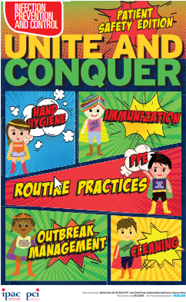
IPAC GTA education funding
IPAC GTA provided Financial support to the membership in 2020-2021
8 members were funded for Conference attendance
7 IPAC Canada Conference
1 Canadian Burn Symposium
2 Health Care facilities were awarded
IPAC Week funding support to support their
IPAC week activities
8 members each awarded $75 for certifying first time in CIC

Slide 13
IPAC WEEK Talk series
Three different speakers provided presentation to the membership in range of topics during IPAC Week (see flyer below for details)
Attendees received IPU points for the sessions.

Slide 14
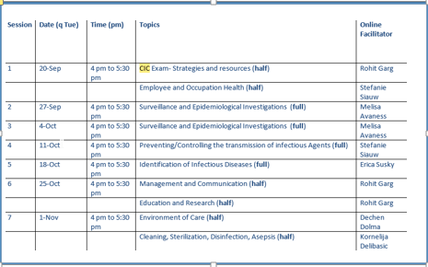
CIC Study Group
IPAC GTA provided CIC study group sessions to the membership (see table below)
There were 94 registrants
The sessions were facilitated by 6 Certified IPAC GTA members via ZOOM platform

Slide 15
Thank you for your consideration
Although the Pandemic made it challenging to personally connect with membership, IPAC GTA maintained engagement by providing IPAC CHAT webinars and a platform to exchange ideas and transfer knowledge.
We are committed to continue engaging and providing service to the membership in various forms such as education funding, platform for providing IPAC education and collaboration with various health care sectors.

